Slide 1

Packages
Introduction
Packages are extensions to R that contain code, data, and documentation. Once installed thay are loaded into R using the function library.
There are 4 mains way to get package for R in bioinformatics :
Bioconductor
CRAN (Comprehensive R Archive Network )
Provides tools for the analysis and comprehension of high-throughput genomic data. See https://www.bioconductor.org/
The Comprehensive R Archive Network is the main source for generic packages. See https://cran.r-project.org/
How to
How to
Check if biocmanager is intalled and install if needed
Command line
if (!requireNamespace("BiocManager", quietly = TRUE))
install.packages("BiocManager")
install.packages("cuteLittlePackage")
Alternative
Install the package
Using R studio go to the menu Tools > Install Packages
BiocManager::install("cuteLittlePackage")
NB: it doesn’t mater which CRAN mirror you choose
Github
Source
Is a repository of development made by anyone, including laboratories. See https://github.com/
Sometime you want a package that is not compiled for your system or not yet publicly available (eg: developped by a collaborator).
How to
How to
Through the package devtools:
Command line
install.packages("devtools")
devtools::install_github("cuteLittlePackage")
install.packages("cuteLittlePackage",
repos=NULL, type="source")
Alternatively through the package remotes
Alternative
install.packages("remotes")
remotes::install_github("cuteLittlePackage")
Using R studio go to the menu Tools > Install Packages
Then select to install from a package archive file
DebuteR | Rpackages installation | nov - 2021

Slide 2
Statistical testing
Introduction
A hypothesis test purpose is to estimate the validity of a statistical hypothesis. It is assumes that the collected data represents properly the studied phenomenon. This cheat sheet is derived from https://biostatgv.sentiweb.fr/?module=tests
 |  |  | 1 Dependant variable (trait of interest)
 |  |  | Categorical nominal dichotomous | Categorical nominal Polytomous | Categorical ordinal | Quantitative / continuous
1 independent variable ( variable with a potential effect on the trait of interest) | Categorical dichotomous | Independent | Test of equal proportions prop.test(n_success,n_trials) | χ² | Cochran-Armitage Packages DescTools | Mann Whitney wilcox.test(x, y)
 |  |  | Χ² chisq.test(frequency_table) |  |  | Student or Welch t t.test(x, y)
 |  |  | Fisher exact fisher.test(frequency_table)
 |  | Paired | McNemar mcnemar.test(x, y) | Cochran’s Q | Sign test Packages DescTools | Paired t test t.test(x, y, paired = T)
 |  |  | Fisher exact |  | Wilcoxon signed rank | Wilcoxon signed rank wilcox.test(x, y, paired = T)
 | Categorical Polytomous | Independent | χ² | χ² | Ordinal Kruskal-Wallis | ANOVA aov(dep. ~ indep., data = dataFrame)
 |  |  |  |  |  | Quantitative Kruskal-Wallis kruskal.test(x, groups)
 |  | Paired | Cochran’s Q Packages DescTools or rstatix | Cochran’s Q | Friedman friedman.test(x, groups) | Friedman
 | Quantitative / continuous |  | Logistic regression glm(dep. ~ indep., family = binomial, data = dataFrame)) | Multinomial logistic regression package nnet | Spearman Correlation cor.test(x, y, method = ‘spearman’) | Pearson correlation cor.test(x, y, method = ‘pearson’)
 |  |  |  |  | Kendall Tau cor.test(x, y, method = ‘kendall’) | Linear regression lm(dep. ~ indep., data = dataFrame)
DebuteR | stat tests in R | nov - 2021
Notes:
Not covered here:
- Multivariate continuous
- Survival
Post-hoc like: Dunn test
Tukey? Dunnet ?

Slide 3
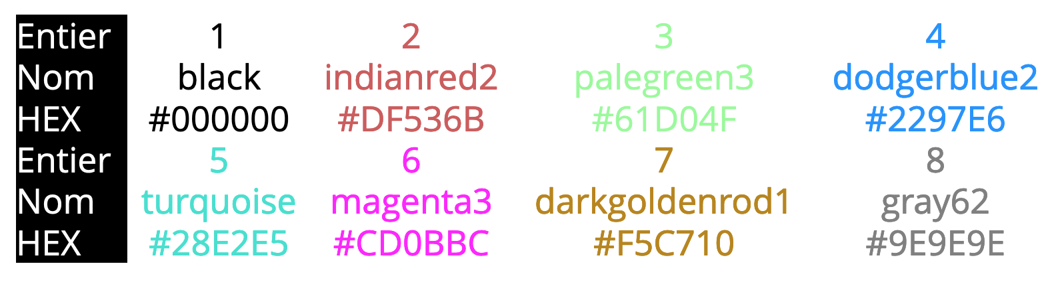
Colors
Introduction
Color is an essential part of most graphs. There are 3 way to use colors in R: hexadecimal codes, named colors or define color palettes
Named & numbered colors
Hexadecimal
Most often used way when setting individual colors
Computeur code of a color. It is composed of 4 parts which takes hexadecimal values from 00 to FF. The first 3 are the red, green and blue colors. The 4th (optional) is the opacity.
How to / example
colors() list all 657 names known to R
Using directly a number instead of a color cycle through 8 predifined colors
col2rgb() get the hexadecimal of a name
How to / example
Use directly (ag: hist(1, col=‘#FF0000AA’) )
Use a function to generate the hexadecimal code:
rgb(r, g, b, maxColorValue=255, alpha=255)
hsv(h, s, v, alpha)
hcl(h, c, l, alpha)
col2rgb(‘slateblue2’)
Color palette
For more informations
Several functions or package help define sets of colors that can be used together
Colors and visualisation guides
https://www.data-to-viz.com/ (not exactly colors, but essential)
https://www.r-graph-gallery.com/index.html
https://colorbrewer2.org/
https://www.datanovia.com/en/blog/top-r-color-palettes-to-know-for-great-data-visualization/
http://www.sthda.com/english/wiki/colors-in-r
How to / example
Base R function: cm.colors topo.colors terrain.colors heat.colors rainbow
Packages: colorspace, colourpicker, RcolorBrewer
RColorBrewer::display.brewer.all()
Some other cheat sheets
Ex. of sequential gradient
https://www.nceas.ucsb.edu/sites/default/files/2020-04/colorPaletteCheatsheet.pdf
https://bootstrappers.umassmed.edu/bootstrappers-courses/pastCourses/rCourse_2014-09/resources/helpfulGuides/Rcolorstyle.pdf
http://www.stat.columbia.edu/~tzheng/files/Rcolor.pdf
Ex. of distinct set
DebuteR | Colors in R | nov - 2021

